Slide 1

Neural Networks
Shea Mowry, Meghan Pinter, Maya Bartels, Felipe Munoz & Han Kahvecioglu

Slide 2
Topic | Who
Intro Neural networks | Han
Training NNs | Felipe
Intro regularization | Maya
Regularization techniques | Shea
Regularization Techniques LASSO and Elastic Net | Maya
MPWD Example | Meghan
Pros and cons (NN, Lasso, EN, Mult. Perceptron) | Shea, Han
Application NN | Felipe
Application Lasso/EN | Maya
Application MPWD | Meghan

Slide 3
Introduction to Neural Networks

Slide 4
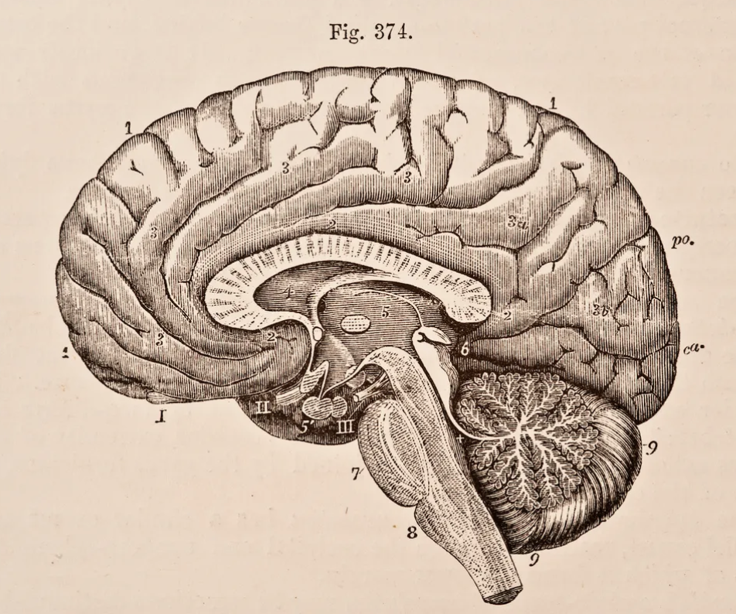
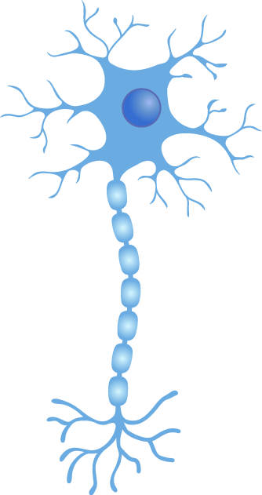
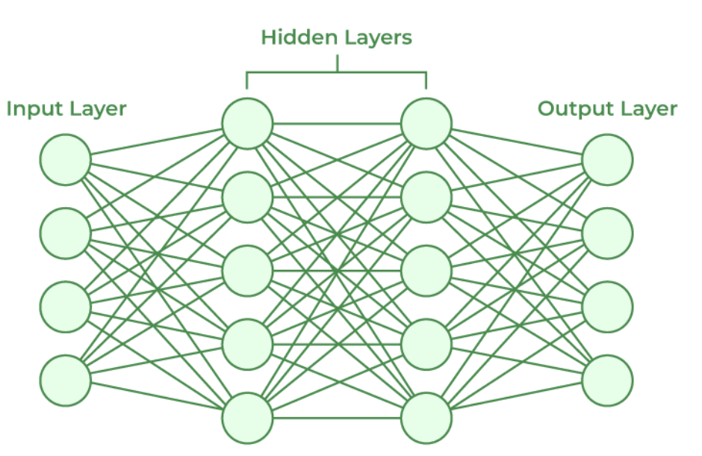
Han
Introduction
Neural networks
Models that mimic how biological neurons work together to:
identify phenomena
weigh options
arrive at conclusions
Node
Simple processing
Organized in layers to conduct:
Complex processing
Notes:
https://www.ibm.com/topics/neural-networks

Slide 5
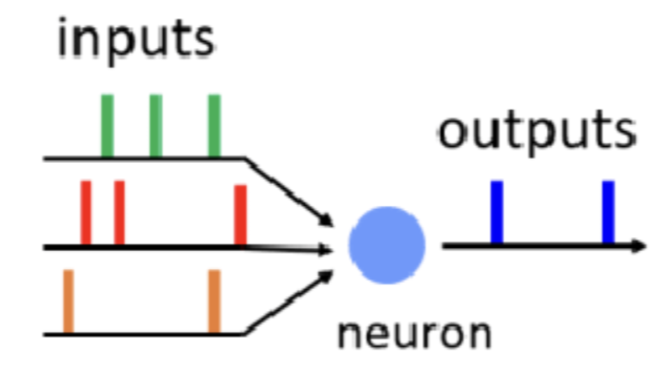
Han
Introduction
Neural networks: general working principle
Biologically, neurons integrate incoming signal and fire if the sum passes a threshold.
Neural nets use this principle as well:
x
Data is summed based on node weights
w₁
output
…
Σ
Σ
y
w₂
If sum exceeds threshold, data is passed to next node
Combination of many of these layers leads to complicated circuits capable of making decisions
w₃
z
b
Incoming nodes are assigned weights
Bias is also added
Notes:
https://www.ibm.com/topics/neural-networks

Slide 6
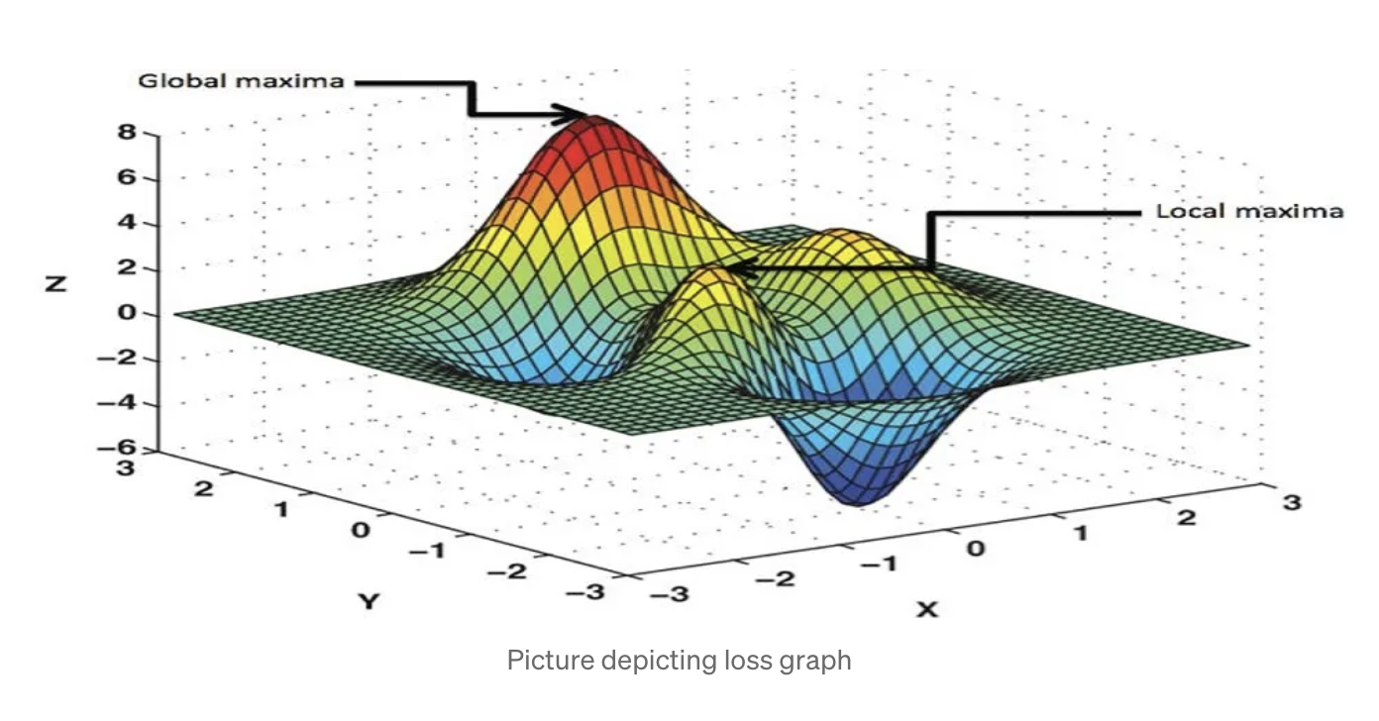
Training Neural Networks
Introduction
Loss function
Measures distance between ground truth and model’s prediction
Function of model parameters
Examples of loss functions
Classification: cross-entropy loss
Regression: L1, L2, Ln loss
Training Objective → Minimize Loss
source: Medium, 2023

Slide 7
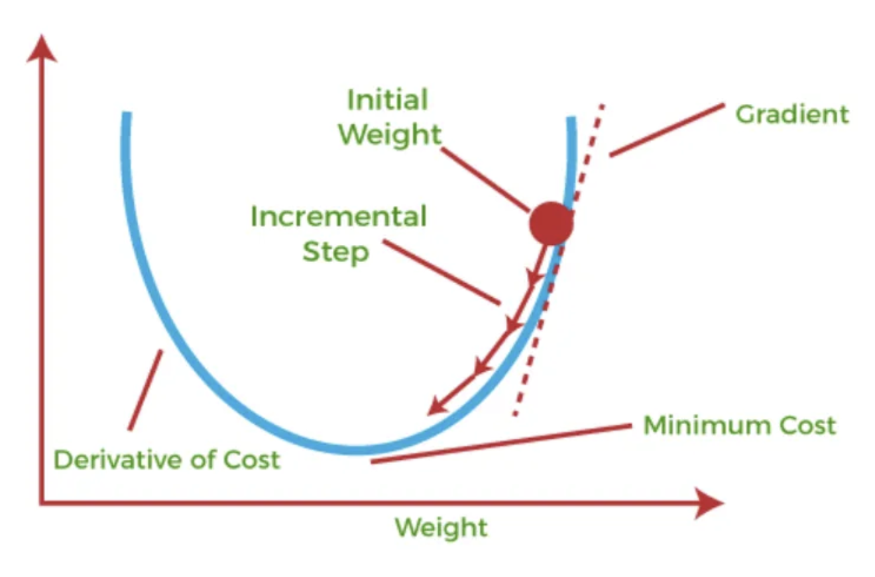
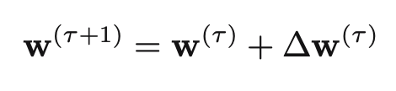
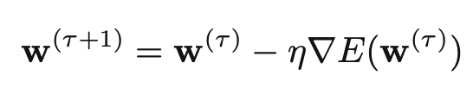
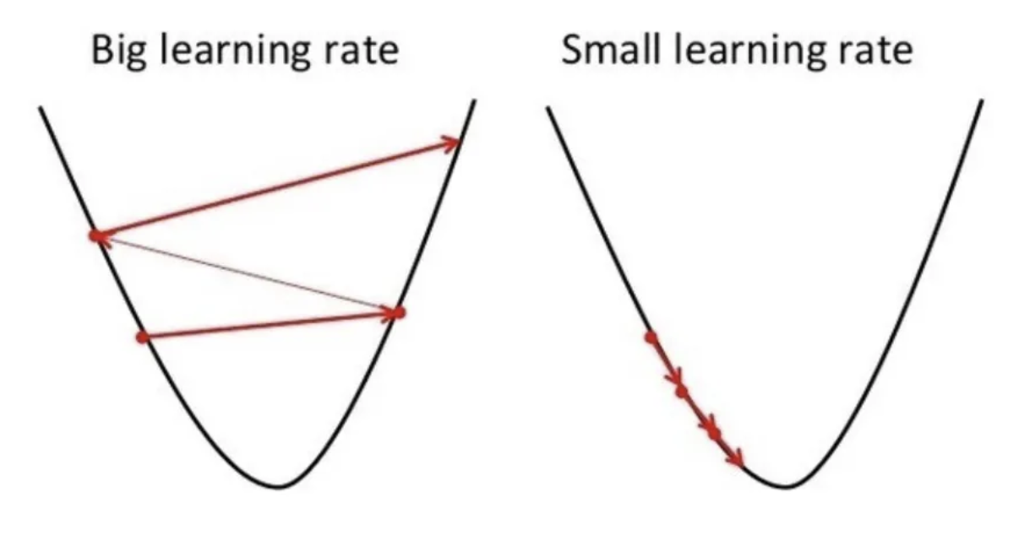
Training Neural Networks
Introduction
How to minimize loss?
Update weights:
Gradient descent:
At each time point, take a step in the direction that minimizes error function
Hyperparameter η (eta) - learning rate
source: Medium, 2024
η - Learning rate
Too big → model might miss minima
Too small → longer training, model may fail to converge
source: Medium, 2024

Slide 8
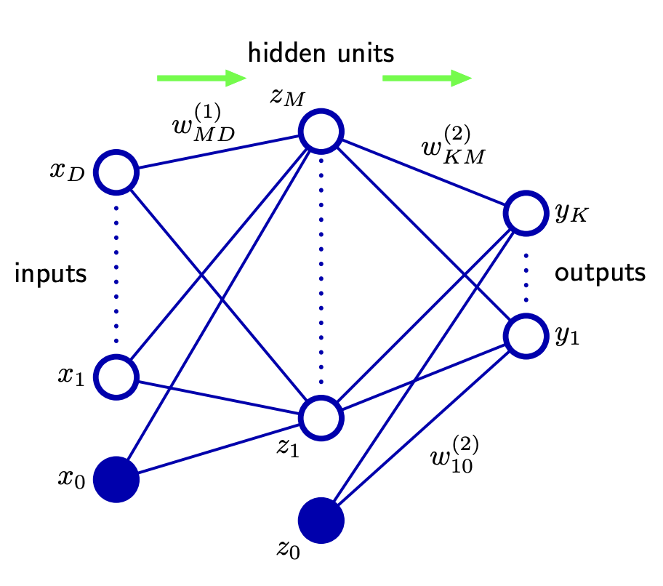
Training Neural Networks
Introduction
Modern neural networks contain billions of parameters
How to calculate gradient with respect to each one?
Answer: Backpropagation
source: Bishop, 2006
Forward Pass
Compute Gradient
Update Weights
Iterate
Process example to produce output
Use loss function to compare output to ground truth
Compute gradient with respect to each parameter using chain rule
Update weights using gradient information
Variants of gradient descent
SGD
Adam
Repeat for n steps
n is a hyperparameter

Slide 9
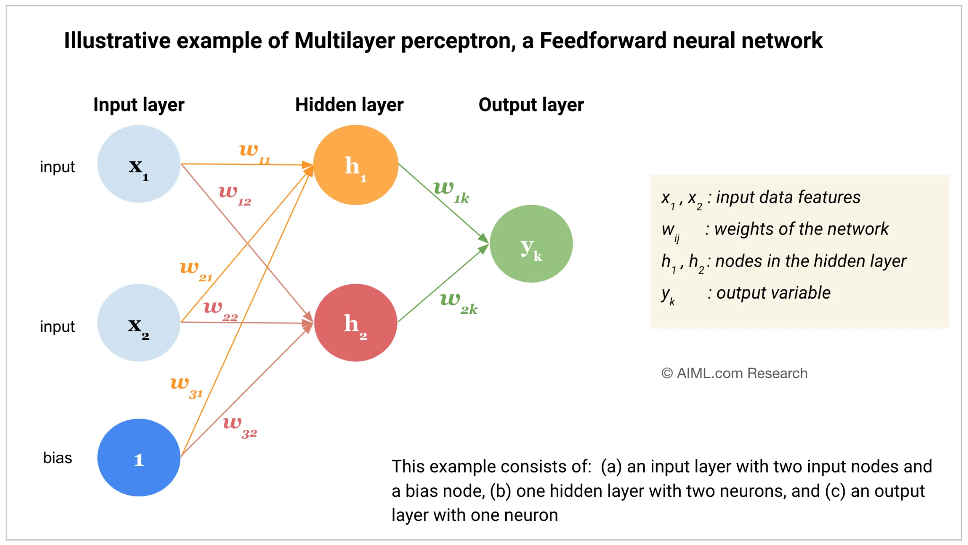
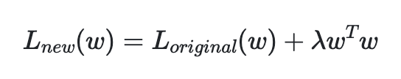
Multilayer Perceptron with Weight Decay - type of NN
Introduction
Multilayer Perceptron (MLP)
One input layer
For each input there is one node
Output layer has single node for each output
Can have any number of hidden layers with any number of nodes
Weight Decay
Regularization technique penalizing large weights
Avoids overfitting
Notes:
Meghan
Feedforward mechanism
One input layer
For each input there is one node (or neuron)
Can have any number of hidden layers with any number of nodes
Output layer has single node for each output
Each node in one layer is connected to every node in the subsequent layer
MLP typically used for supervised learning tasks like classification and regression
Weight decay is also known as L2 regularization
L2 regularization formula is demonstrated by this equation where lambda is the weight decay coefficient
Regularization technique penalizing large weights
Avoids overfitting

Slide 10
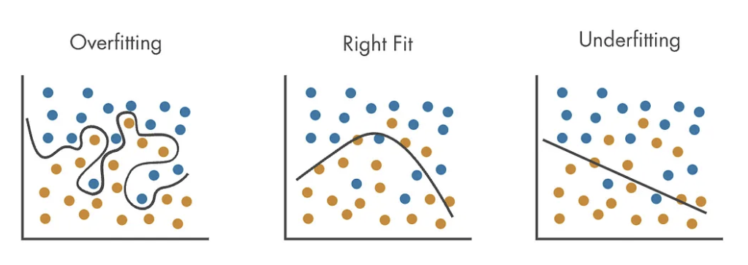
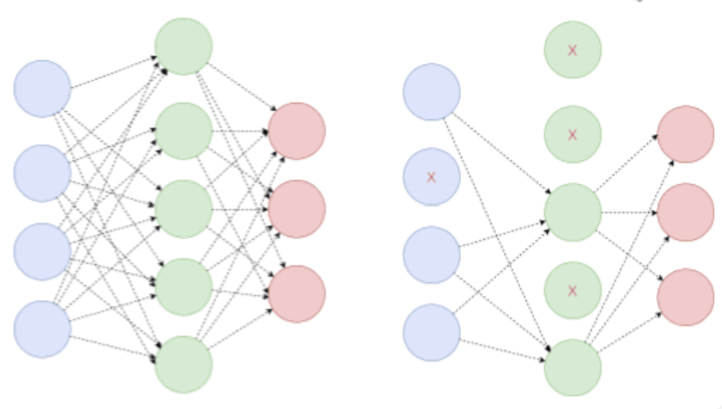
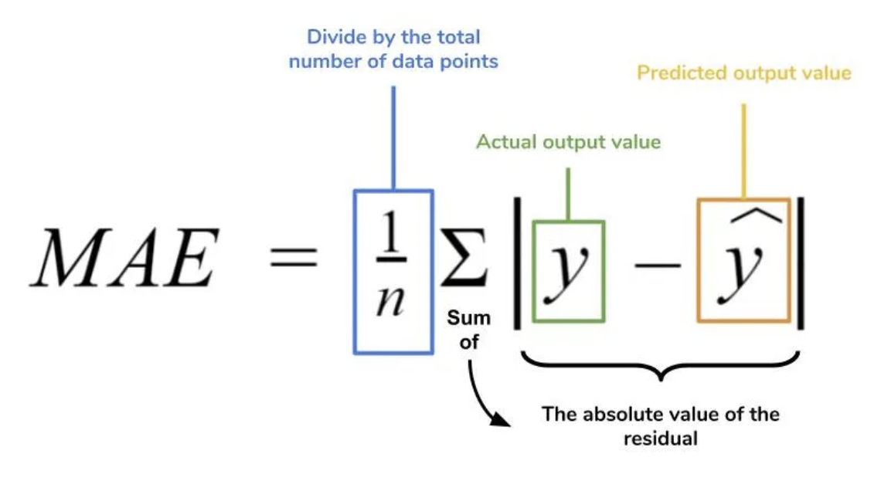
Intro to Regularization
Introduction
Prevent overfitting
Make model more generalizable and make accurate predictions about new data
Penalize the cost function helps prevent overfitting by discouraging the model from becoming too complex.
Different regularization techniques have different penalization methods.
Notes:
Maya

Slide 11
Regularization Techniques

Slide 12
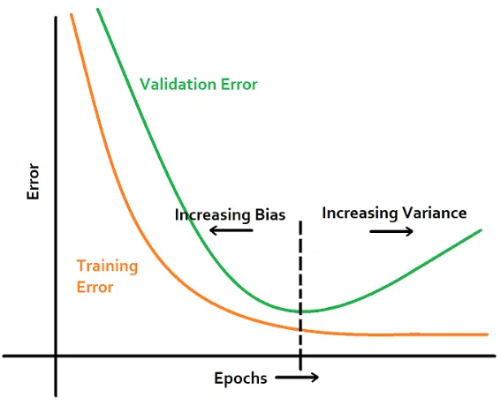
Early stopping
Regularization Techniques
Stops when the models starts performing poorly to avoid overfitting
Determined by:
Training Error decreasing
Validation Error increasing
Or both
Notes:
Early stopping stops training the model when the training error decreases too much or validation error increases to avoid overfitting the data. This technique essentially avoids memorization of your training data.

Slide 13
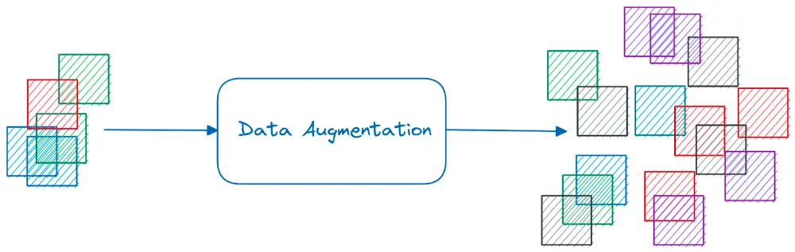
Data augmentation
Regularization Techniques
Create a more diverse data set from existing data via
Color space transformations such as change of pixel intensities
Rotation and mirroring
Noise injection, distortion, and blurring
Cutout, CutMix, and AugMix (removing or changing data)
Notes:
Sometimes with a small limited data set, you can be prone to overfitting and issues with your model. To avoid this you can also carry out data augmentation to create a more diverse data set from the limited data you have. To do this for image based data sets you can use color space transformations, rotations, or mirroring. For other types of data and for images you can also distort, add noise to your data, or cut out data. Specifically, common methods include Cutout, CutMix and AugMix.

Slide 14
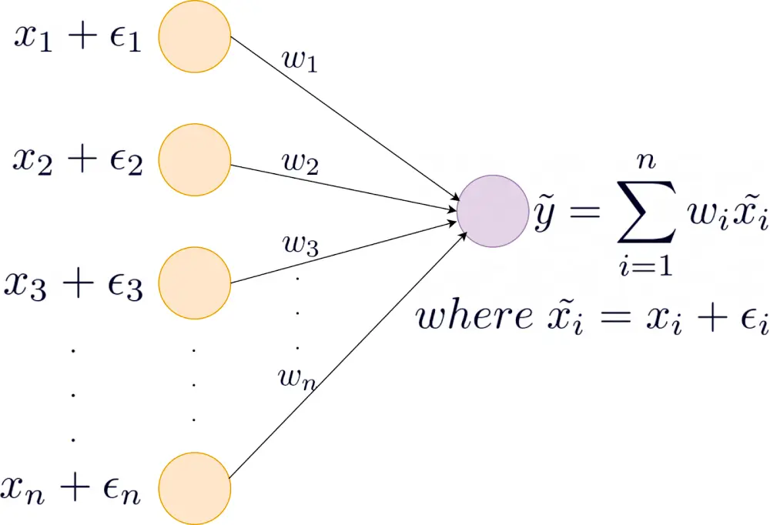
Addition of Noise
Regularization Techniques
Noise can also be added to:
Input data
Output labels
Gradients
Weights
Unique, random noise
Notes:
Adding noise means that the network is less able to memorize training data because the training set is changing all the time. This results in smaller network weights (w here, no one branch carrying too much weight) and a more robust network that has lower generalization error.
If you add too little noise, there is no impact on the models tendency to memorize the training data. If you add too much noise, the mapping function may become too challenging to learn.
You can add noise using a random vector (the epsilon here, with each input being a unique random value). You can add noise to inputs before it is presented to the network, so that, you can reuse the data with different random vectors added each time.
If you expect your model may face mislabelling due to quality issues with your data set or class imbalances, you can also combat this by adding noise to the class labels. You can also add noise to the gradients and weights, again to avoid memorization and overfitting.

Slide 15
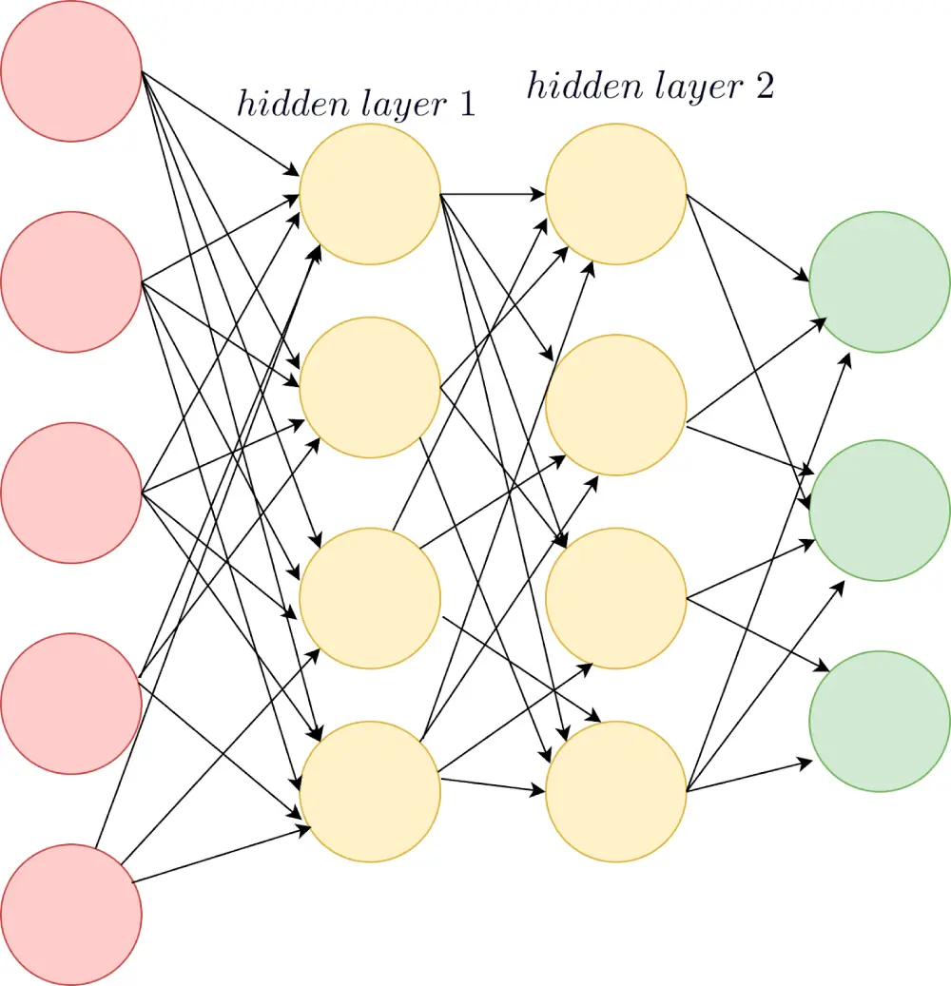
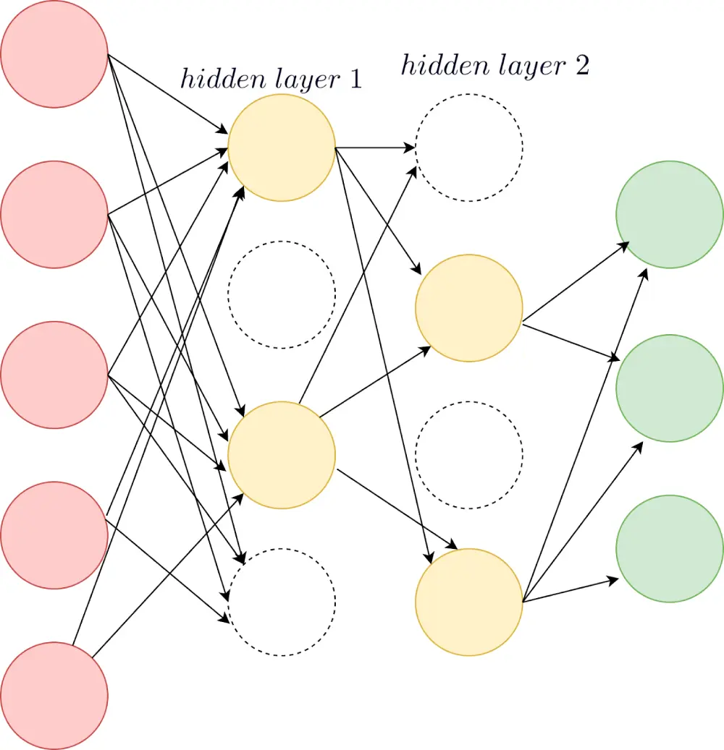
Dropout
Regularization Techniques
Creates slightly different network architectures each time
Dropping based on a “drop probability”
Notes:
This method is equivalent to training different neural networks on different subsets of the training data (which would be more computationally demanding). It takes a general network architecture and drops nodes from the intermediate layers using a “drop probability” which you can input. So you can say choose a drop probability of 50% in which case each node as a 50% chance of being included or excluded in the network.
Since all the neurons are present in the network during testing, we can account for the dropouts during training by weighting each neuron’s output by the same drop probability. This means the weight of each neuron is proportional to the fraction of time the neuron was present during the training.

Slide 16
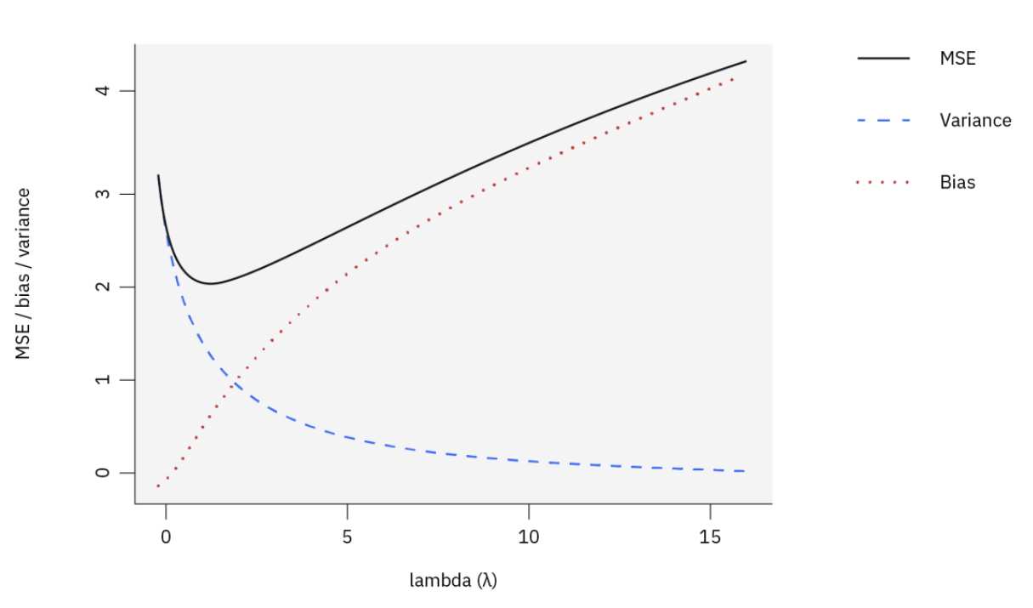
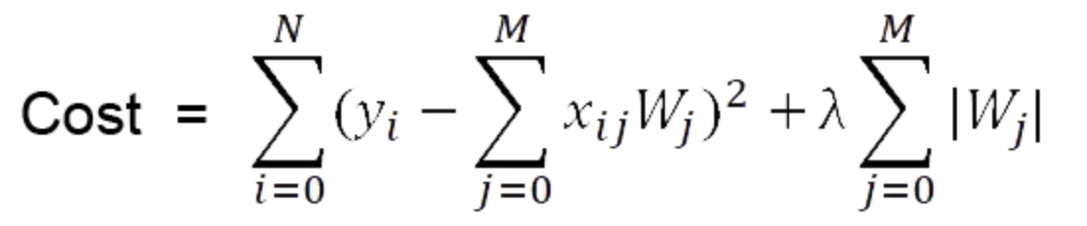
LASSO Regularization Technique
Regularization Techniques
Performs variable selection and regularization to enhance prediction accuracy and interpretability
Selects more relevant features from input features
shrinks some feature weights to 0 to remove them and only use relevant features
Uses L1 penalty to reduce coefficients to 0
Choose a lambda value that balances bias and variance
Notes:
Maya

Slide 17
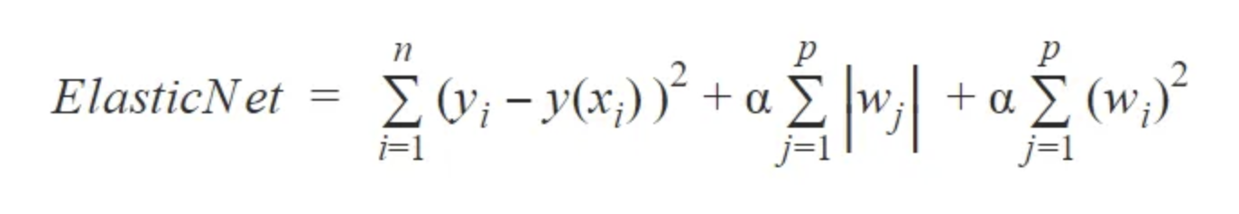
Elastic Net Regularization Technique
Regularization Techniques
Combines L1 (Lasso) and L2 (Ridge) regularization techniques
Controls cost balance and penalizes complexity in the model
Uses alpha (regularization parameter)
alpha = 0 → no L1 or L2 applied
alpha = 1 → L1 and L2 are both applied
0 < alpha < 1 → mixture of L1 and L2 are applied
Regularization Terms
Notes:
Maya

Slide 18
Neural Networks Pros & Cons
Strengths:
Useful to capture complex patterns (non-linear relationships)
Adaptability (can change and improve overtime as fed more data)
Tolerant to noise (useful for biological data)
Can be generalized to unseen data
Weaknesses:
Requires large data set
Computationally intensive
Black box nature (unclear HOW)
Prone to overfitting
Notes:
https://resources.experfy.com/ai-ml/pros-and-cons-of-neural-networks/

Slide 19
Multilayer Perceptron with Weight Decay Pros & Cons
Strengths:
Reduces overfitting & improves generalization
Ability to work with non-linear problems
Prevents over-reliance on single data features
Weaknesses:
Difficult to find right hyperparameter (weight decay coefficient λ)
Increased computational complexity
Does not account for bias
Notes:
Meghan
Pros:
Reduces overfitting fitting noise in training data by penalizing large weights, leading to better generalization on unseen data. Model learns simpler, more robust patterns, improving performance on test data
MLP solves non-linear problems with the use of non-linear activation functions in the hidden layers, which allows the model to capture complex relationships between inputs and outputs
MLP also prevents over reliance on single data features influencing the regularization of the whole data set. A Feature refers to the individual input variables that the model uses to make predictions, they are measurable properties of the data. This model prevents over reliance on certain data features, overall leading to a more representative look at the data.
Cons:
Finding the right value for λ can be challenging. A poorly chosen weight decay parameter can either have little effect or harm model performance.
Increased computational complexity could increase overall cost of the model and time to perform
Weight decay typically doesn’t apply to biases so if biases become disproportionately large or important, the model could still overfit
Pros:
Reduces Overfitting: Weight decay helps prevent the model from fitting noise in the training data by penalizing large weights, leading to better generalization on unseen data.
Improved Generalization: By controlling the magnitude of the weights, weight decay encourages the model to learn simpler, more robust patterns, improving performance on test data.
Smoother Decision Boundaries: The penalization of large weights leads to smoother and less complex decision boundaries, which can improve the model’s ability to make predictions on varied data.
Regularization with Minimal Changes: Weight decay is easy to implement as it only requires a small modification to the loss function, making it a convenient and effective regularization technique.
Mitigates Over-reliance on Features: It prevents the model from relying too heavily on any one feature, distributing the importance more evenly across multiple features.
Cons:
Risk of Underfitting: If the weight decay coefficient (λ\lambdaλ) is too large, the model may overly penalize weights, leading to underfitting where the model is too simple to capture important patterns in the data.
Requires Hyperparameter Tuning: Finding the right value for λ\lambdaλ can be challenging. A poorly chosen weight decay parameter can either have little effect or harm model performance.
Slower Training: Weight decay can make the gradient descent process slower because it adds a regularization term to the optimization objective, which can lead to more cautious updates to the weights.
Limited by Architecture: While weight decay improves generalization, it doesn’t fix limitations of the network architecture itself, such as the inability to capture complex, hierarchical features (which may be addressed by more advanced architectures like convolutional or recurrent neural networks).
Bias Remains Unaffected: Weight decay typically does not apply to biases, so if biases become disproportionately large or important, the model could still overfit in some cases.

Slide 20






Comparison of regularization techniques
LASSO
Suitable for high-dimensional data
(chooses the most important data)
Not well-suited for datasets with correlated features
Elastic Net
Can handle highly correlated sets
(even collinearity)
High computational cost
Early stopping
Prevents memorization
(better generalization)
Risk of premature stopping
Noise Addition
Prepared model for noisy real world data (audio, image, etc.)
Longer time to converge to solution
Data augmentation
Good for when not enough data, especially comp. vision tasks
Risk of generating irrelevant data
Dropout
Prevents too much relying of neurons to one another
Incompatible with crucial layers

Slide 21
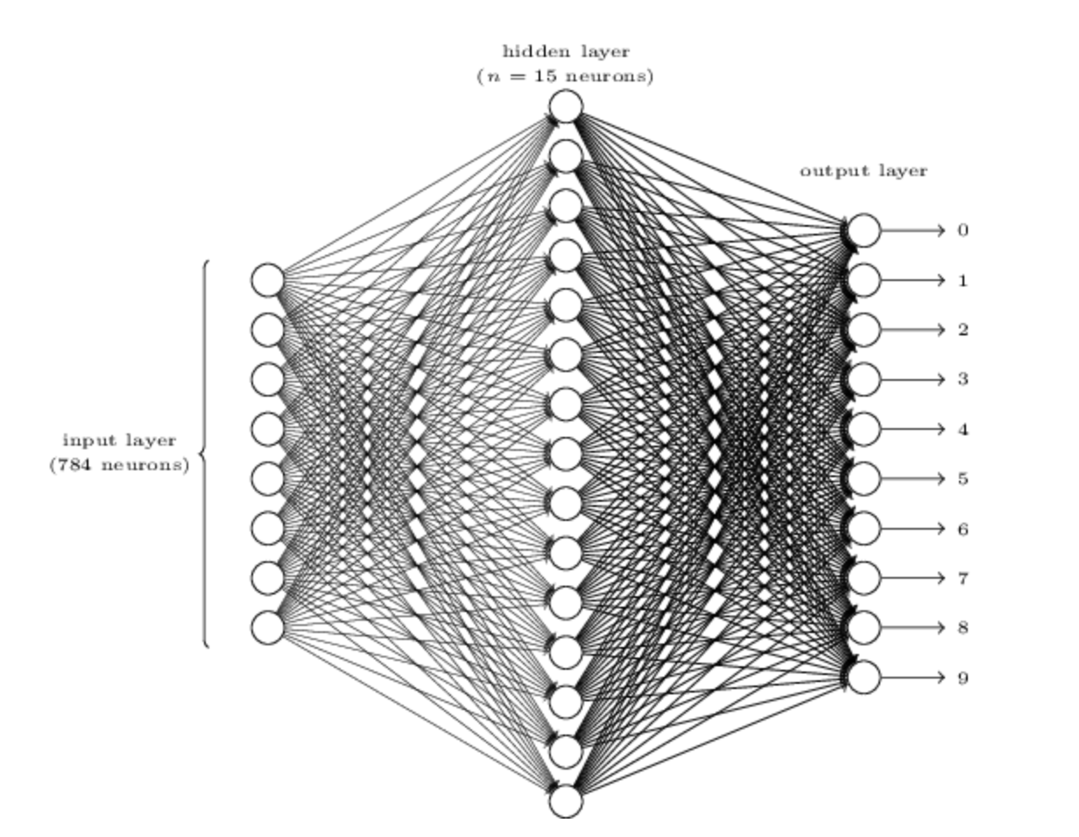
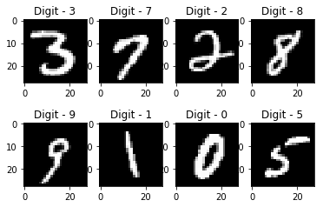
Application of MLP with Weight Decay
Handwritten digit recognition
Handwritten digits have complex, non-linear patterns
Hidden layers can capture these patterns
Weight decay helps prevent overfitting of noisy patterns
Notes:
Meghan
Handwritten digit recognition is a practical example of an MLP with weight decay.
Handwritten digits have complex, non-linear patterns and hidden layers can capture these patterns and learn representations that distinguish between different digits.
The non-linear structure of the MLP captures complex features of the digits, while weight decay regularizes the model, preventing overfitting and improving its ability to generalize to new data.
In this example, The input layer contains neurons encoding the values of the input pixels
The second layer of the network is the hidden layer. they denoted the number of neurons in this hidden layer by n, but n can be many different values in different settings, in this case n=15.
The output layer of the network contains 10 neurons. If the first neuron fires, i.e., has an output ≈1 then that will indicate that the network thinks the digit is a 0. If the second neuron fires then that will indicate that the network thinks the digit is a 1 And so on. …
MLP with weight decay is widely used in applications like optical character recognition (OCR) for document digitization and handwriting analysis.

Slide 22

Applications of LASSO and Elastic Net
Immunological data has high dimensionality
Regularization techniques such as LASSO and Elastic Net can help prevent overfitting with high dimensional datasets
Penalizes cost function and makes the model more generalizable to new data
Removes unnecessary features from the model to reduce complexity
Less complex often means a better neural network algorithm
Makes model more interpretable for use on future datasets
Notes:
Maya

Slide 23
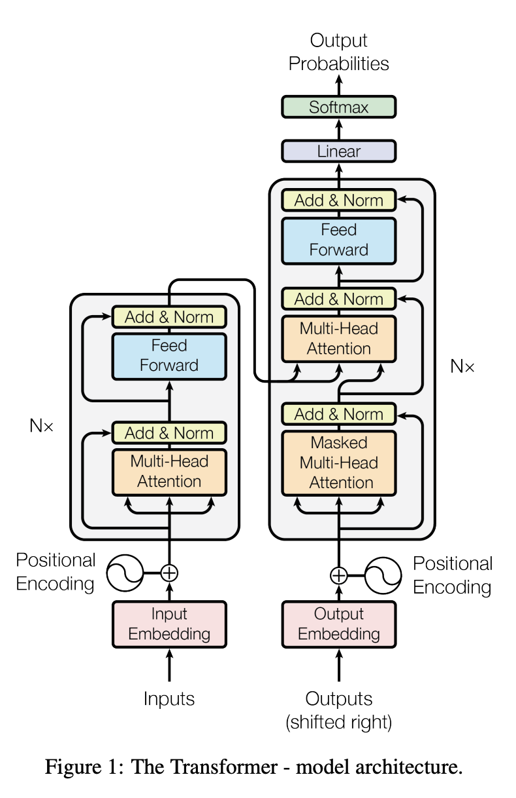

Applications: Transformer
Transformer
Captures relationships in sequential data (text)
Foundation of modern AI models
GPT, BERT

Slide 24
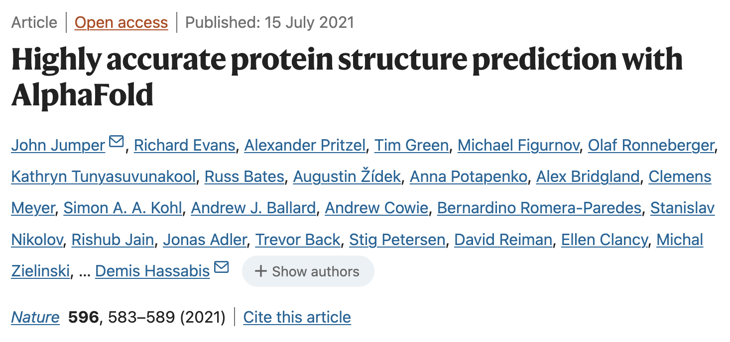
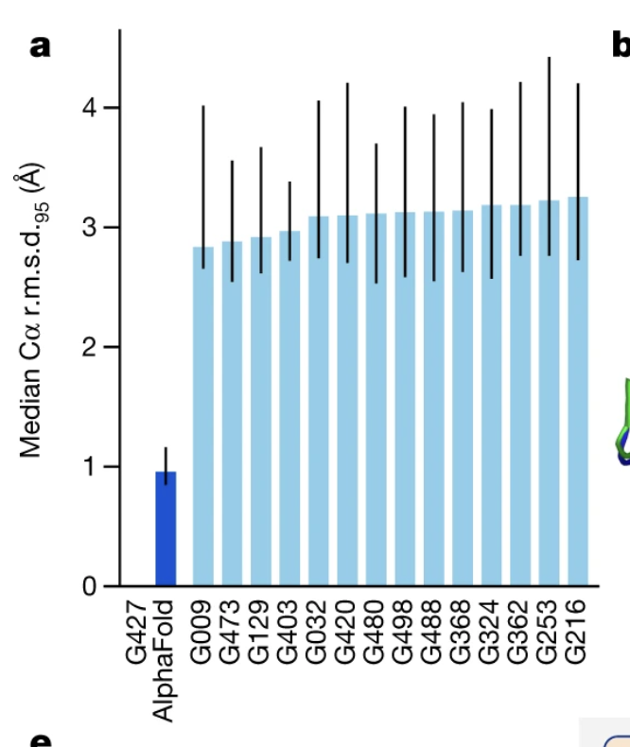
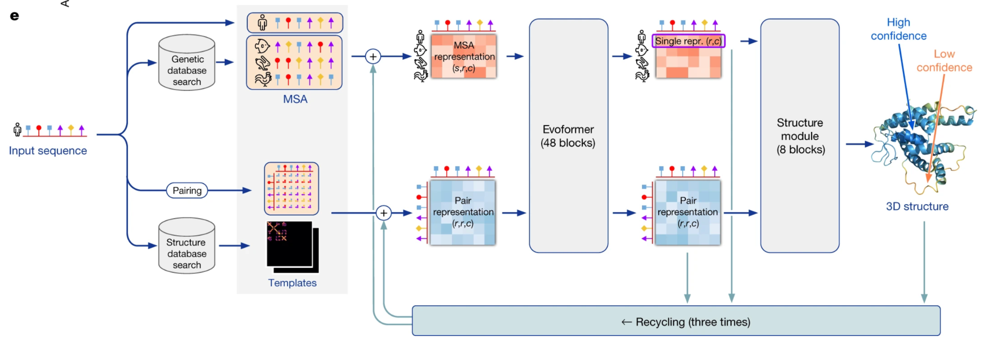
Applications: AlphaFold
Evoformer - inspired by transformer
Other structure predictors - RoseTTAFold, ESM

Slide 25
Resources
Bourzac, K. (2017, April 14). Explained: Neural networks. MIT News. https://news.mit.edu/2017/explained-neural-networks-deep-learning-0414
IBM. (n.d.). Lasso regression. IBM. https://www.ibm.com/topics/lasso-regression#:~:text=In%20lasso%20regression%2C%20the%20hyperparameter,simpler%20model%20with%20fewer%20parameters
Jain, A. (2020, May 19). Elastic net regression: Combined features of L1 and L2 regularization. Medium. https://medium.com/@abhishekjainindore24/elastic-net-regression-combined-features-of-l1-and-l2-regularization-6181a660c3a5
Singh, P. (2019, October 15). L1 vs L2 regularization: Which is better? Medium https://medium.com/analytics-vidhya/l1-vs-l2-regularization-which-is-better-d01068e6658c
AI Mind. (2020, February 18). Regularization techniques in Keras neural networks. AI Mind. https://pub.aimind.so/regularization-techniques-in-keras-neural-networks-2ec3ae48a764
The AI Summer. (n.d.). Regularization techniques in machine learning. The AI Summer. https://theaisummer.com/regularization/
GeeksforGeeks. (2021, November 28). Multi-layer perceptron learning in TensorFlow. GeeksforGeeks. https://www.geeksforgeeks.org/multi-layer-perceptron-learning-in-tensorflow/
D2L.ai. (n.d.). Chapter: Multi-Layer Perceptrons, Weight decay. In Dive into Deep Learning https://classic.d2l.ai/chapter_multilayer-perceptrons/weight-decay.html
Brownlee, J. (2019, November 6). How to reduce overfitting in deep learning with weight regularization. Machine Learning Mastery. https://machinelearningmastery.com/how-to-reduce-overfitting-in-deep-learning-with-weight-regularization/
Nielsen, M. (n.d.). Chapter 1: Introduction. In Neural Networks and Deep Learning. http://neuralnetworksanddeeplearning.com/chap1.html

Slide 26
Team 4 - Irun Cohen: Neural Networks and Regularization 🧠🔗
Members: Shea Mowry, Han Kahvecioglu, Maya Bartels, Felipe Munoz, Meghan Pinter
Focus Algorithms: nnet (Neural Network), mlpWeightDecay (Multilayer Perceptron with Weight Decay)
What to do:
Introduce neural networks and regularization techniques.
Explain how Neural Networks and Multilayer Perceptron with Weight Decay work, their strengths, weaknesses, and key differences.

